Slide 1


Slide 2


Slide 3
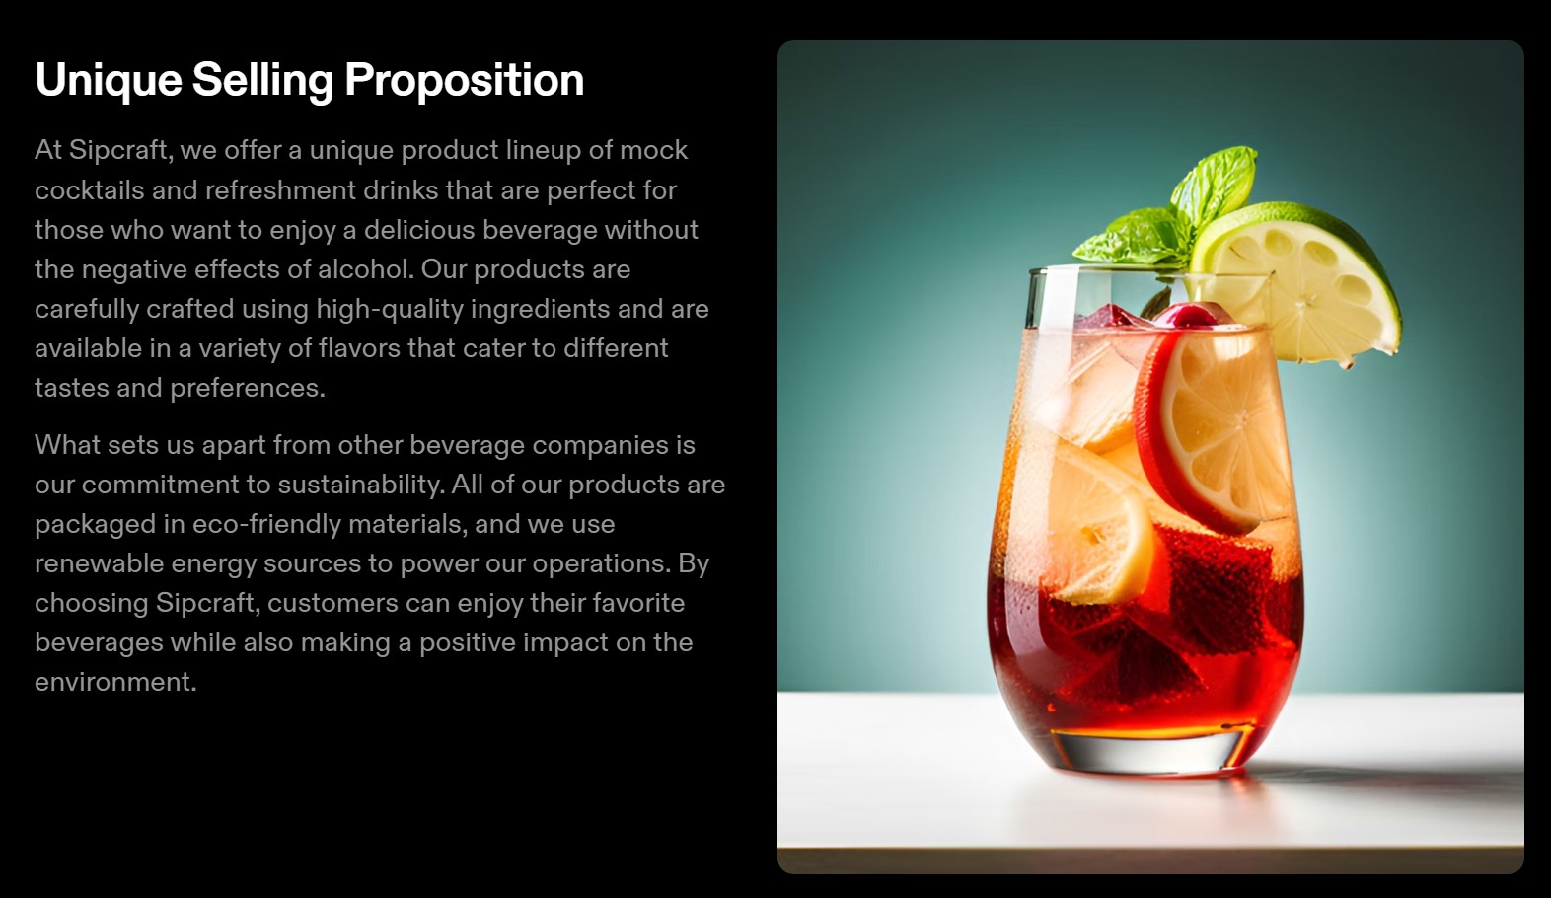
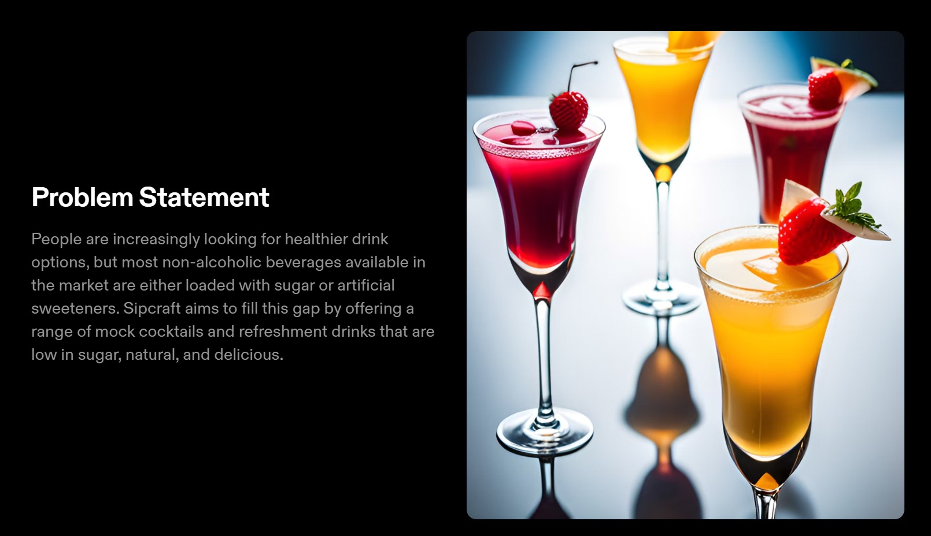

Slide 4


Slide 5


Slide 6



JS
The Hyper Text Markup Language or HTML is the standard markup language for documents designed to be displayed in a web browser. It defines the meaning and structure of web content.
Cascading Style Sheets (CSS) is Cascading Style Sheets (CSS) is a style sheet language used for describing the presentation of a document written in a markup language such as HTML
JS is a dynamic programming language used for web development game development. It allows developers to implement dynamic features on web pages that cannot be done with only HTML and CSS.

Slide 7



STRIPE
SWEETALERT
FIREBASE
It provides a range of tools and services to handle payment processing, subscription management
SweetAlert is a replacement for the "window.alert()" function of JavaScript that shows wonderful modal popup windows.
It provides a wide range of services and tools to support including authentication, real- time databases, cloud storage, hosting,

Slide 8


SMTP
EASTIC EMAIL
CLOUDFLARE
V
It is a server Which connects
senders email to the
SMTP server
Its function is to verify email and verify domain of our site
With this we can make SPF,DKIM, CNAME keys.

Slide 9


Slide 10


